Slide 1
OpinifyHub Survey Management System
Group Activity
Faculty: Dr. Bhupendra Panchal

Slide 2
20BCE10053
20BCE10151
20BCE10154
Meet Our Team
Amar Kumar
Mritunjay Kumar
Shivam Nandy

Slide 3
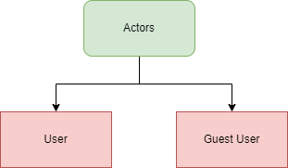
Introduction
It will empower the development, distribution and analysis of survey forms to improve communication, process management, and decision support. The user who can add questions and surveys and view the survey results and the guest user who can answer those surveys.
To access the survey created you need to share survey code of 5 characters with your actor.
There are few terminologies which are required to know before we proceed:
Swing
AWT
SQL

Slide 4

Application of Survey Management System
Our survey management system offers numerous uses and applications across various domains:
• Market Research
• Customer Feedback and Satisfaction
• Employee Engagement and Feedback
• Academic Research
• Social and Political Surveys
• Event Feedback and Evaluation
• Healthcare and Patient Satisfaction

Slide 5
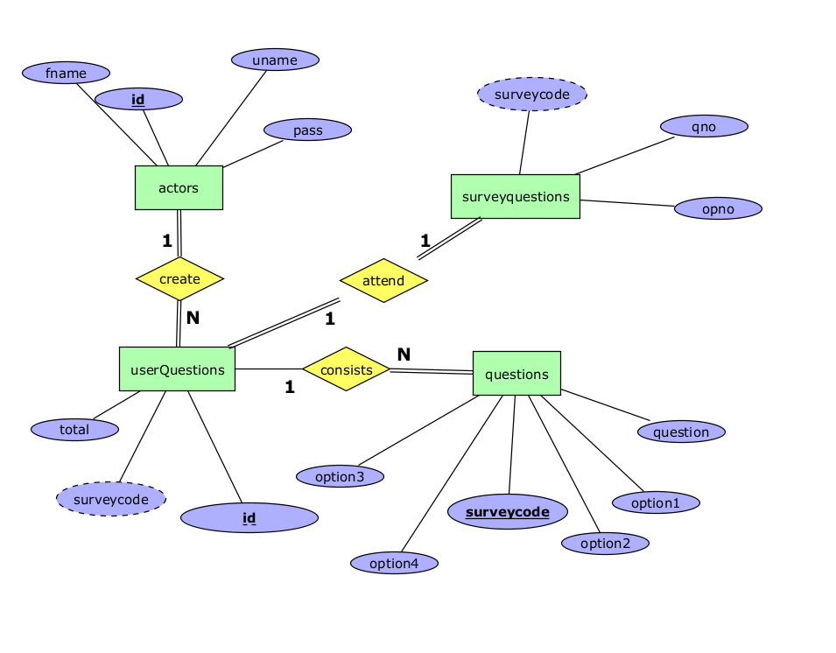
ER Diagram:

Slide 6
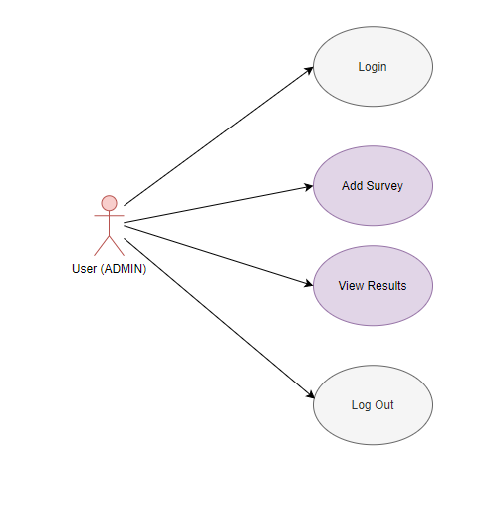
Use Case Diagram: (User)

Slide 7
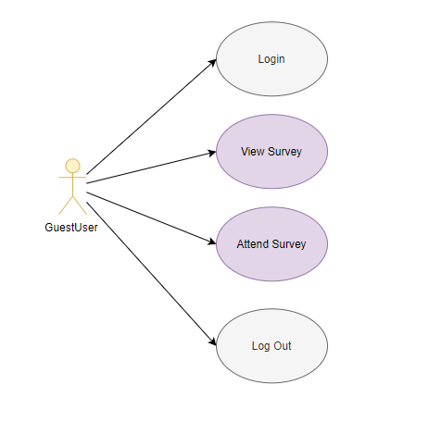
Use Case Diagram: (GuestUser)

Slide 8
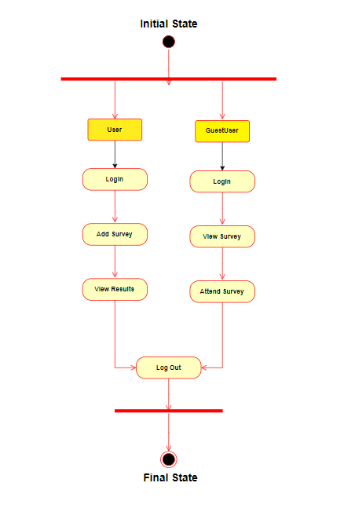
Activity Diagram

Slide 9
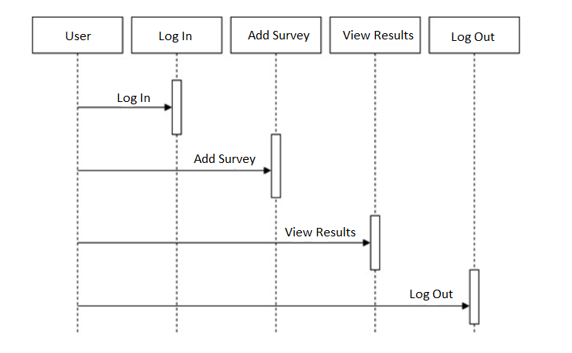
System Sequence Diagram
System Sequence Diagram for User

Slide 10
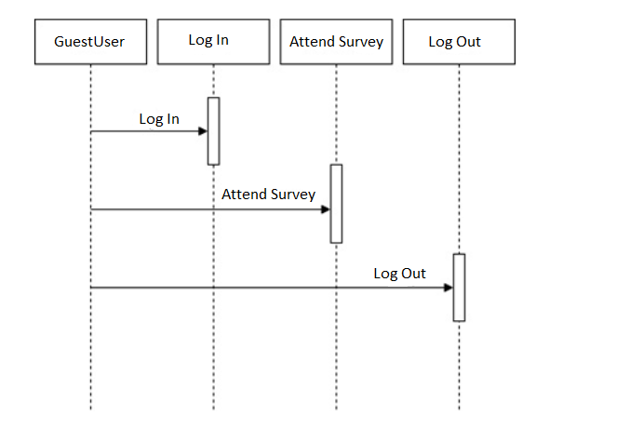
System Sequence Diagram
System Sequence Diagram for GuestUser

Slide 11
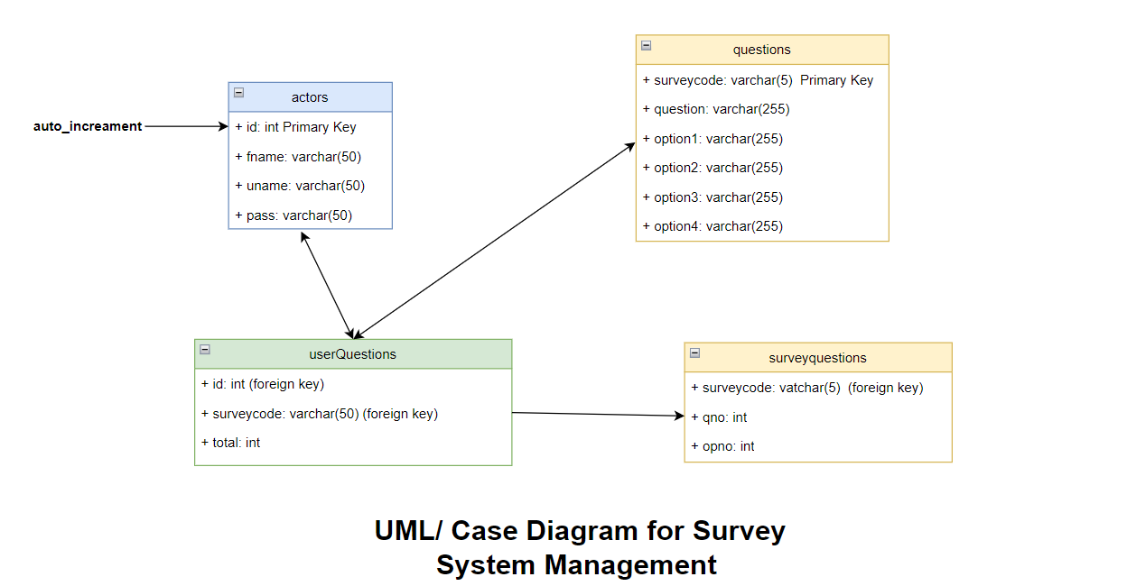
UML/ Class Diagram

Slide 12
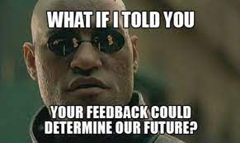

THANK YOU
Do you have any questions?

